Slide 1
Risk-Based Testing
Dr Mu Yang
COMP6236 - Software Engineering and Cyber Security

Slide 2
Today
Why risk-based testing?
What is risk-based testing?
What is the process?
Small tasks

Slide 3
Why risk-based testing?
For any complex system, an infinite number of tests exist...
...but you don’t have forever to test!

Slide 4
Why risk-based testing?
For any complex system, an infinite number of tests exist...
...but you don’t have forever to test!
So, out of the infinite cloud of possible tests, testers must select a finite number

Slide 5
Why risk-based testing?
For any complex system, an infinite number of tests exist...
...but you don’t have forever to test!
So, out of the infinite cloud of possible tests, testers must select a finite number
Testing is always under pressure
Testing is the last thing done in a project

Slide 6
Why risk-based testing?
For any complex system, an infinite number of tests exist...
...but you don’t have forever to test!
So, out of the infinite cloud of possible tests, testers must select a finite number
Testing is always under pressure
Testing is the last thing done in a project
Testers must be able to cut down the least important things

Slide 7
Risk-based testing
Risk based testing is basically a testing done for a project based on risks.
Risk based testing uses risk to prioritize and emphasize the appropriate tests.

Slide 8
Risk-based testing
Objective
Find the most important defects as early as possible at the lowest price

Slide 9
Risk-based testing
Objective
Find the most important defects as early as possible at the lowest price
Business based decision
Risk-based testing involves key business and technical project stakeholders to align the focus and sequence of testing

Slide 10
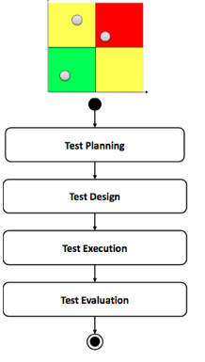
Risk-based testing
Risk assessment
results

Slide 11
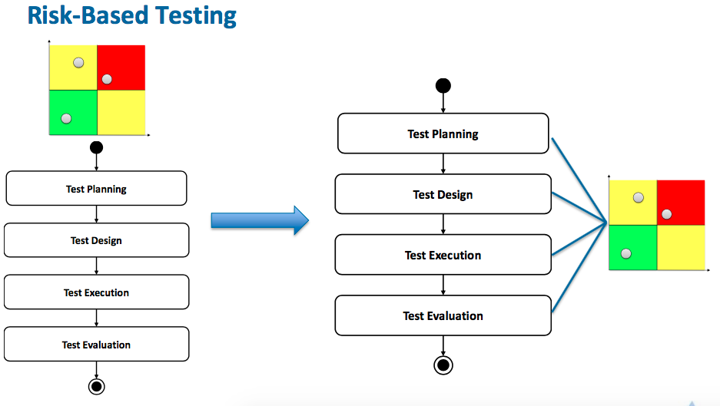
Risk-based testing
Risk assessment
results

Slide 12
RBT process

Slide 13
Risk-based testing
What is testing?
“The evaluation of software by observing its execution”

Slide 14
Basic concepts of testing
Test planning is the activity of establishing or updating a test plan.
A test plan is a document describing the objectives, scope, approach, resources, exit criteria, and schedule of intended test activities.

Slide 15
Basic concepts of testing
Test planning is the activity of establishing or updating a test plan.
A test plan is a document describing the objectives, scope, approach, resources, exit criteria, and schedule of intended test activities.
- Functional behaviour of a system
- Nonfunctional properties

Slide 16
Basic concepts of testing
Test planning is the activity of establishing or updating a test plan.
A test plan is a document describing the objectives, scope, resources, exit criteria, and schedule of intended test activities.
Components
Integration
Complete system

Slide 17
Basic concepts of testing
Test planning is the activity of establishing or updating a test plan.
A test plan is a document describing the objectives, scope, resources, exit criteria, and schedule of intended test activities.

Slide 18
Basic concepts of testing
Test planning is the activity of establishing or updating a test plan.
A test plan is a document describing the objectives, scope, resources, exit criteria, and schedule of intended test activities.
Conditions on when to stop

Slide 19
Basic concepts of testing
Test planning is the activity of establishing or updating a test plan.
A test plan is a document describing the objectives, scope, resources, exit criteria, and schedule of intended test activities.

Slide 20
Basic concepts of testing
Test designing transforms the test plan into
tangible test conditions
abstract test cases

Slide 21
Basic concepts of testing
Test execution comprises tasks to execute test cases
Making the abstract test cases executable
Preparing test harnesses and test data
Providing logging support
Writing test scripts
Executing test cases
Logging test results

Slide 22
Basic concepts of testing
Test evaluation evaluates the exit criteria and logged test results
Output: a test report

Slide 23
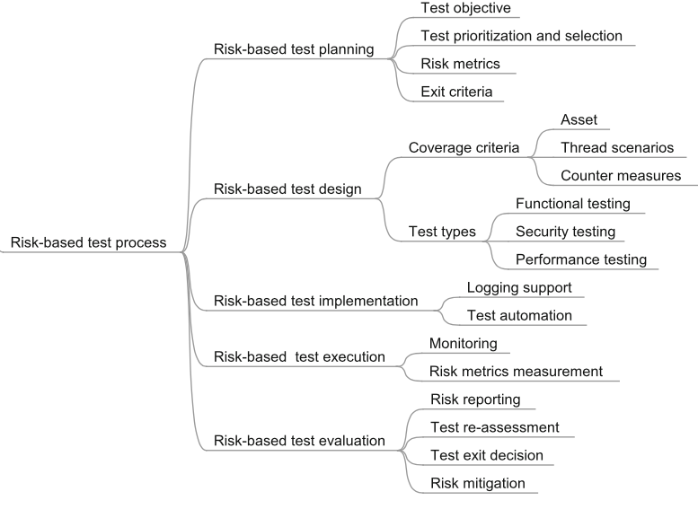
RBT process
RBT process

Slide 24
RBT process
- Risk items are added
- Test the countermeasures
RBT process

Slide 25
RBT process
High risk -> serious testing
Test cost vs fault detection capability
To quantify different aspects in testing
E.g., minimum level of testing

Slide 26
RBT process
Risk artifacts
Risk drivers

Slide 27
RBT process
Risk artifacts
Risk drivers
Penetration testing

Slide 28
RBT process
Adapt to risk items
Risks are to guide decisions where and to what degree testing should be automated

Slide 29
RBT process
Unlike normal software testing

Slide 30
RBT process
Risk level
Actual vs. assessed risk

Slide 31
RBT process
Risk level
Actual vs. assessed risk

Slide 32
RBT – A Case Study
RBCS Software Testing Training & Consulting
rbcs-us.com/

Slide 33
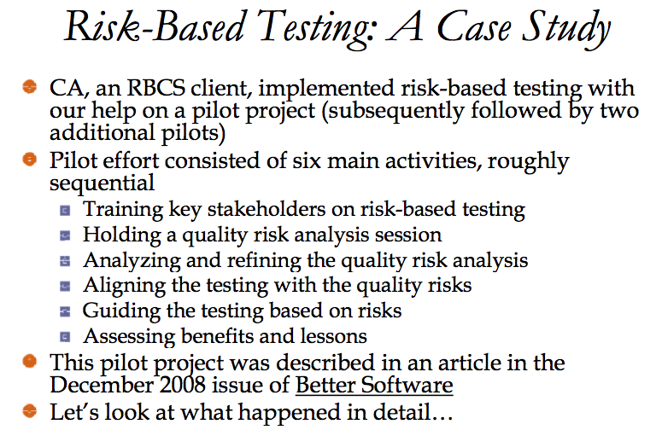
RBT – A Case Study

Slide 34
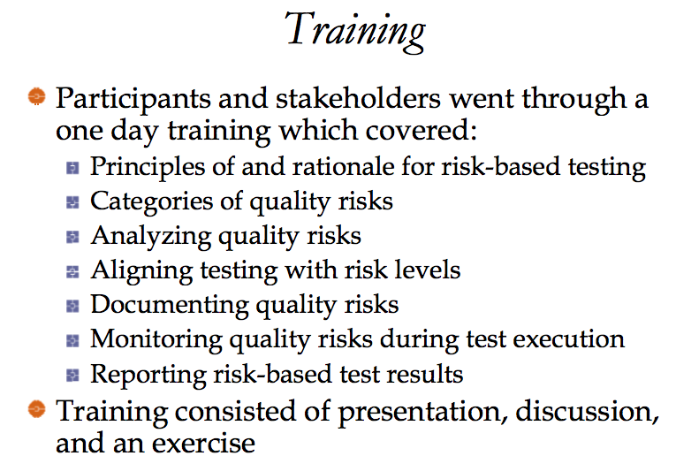

Slide 35
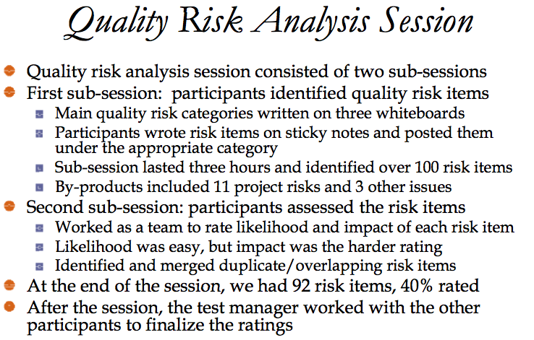

Slide 37
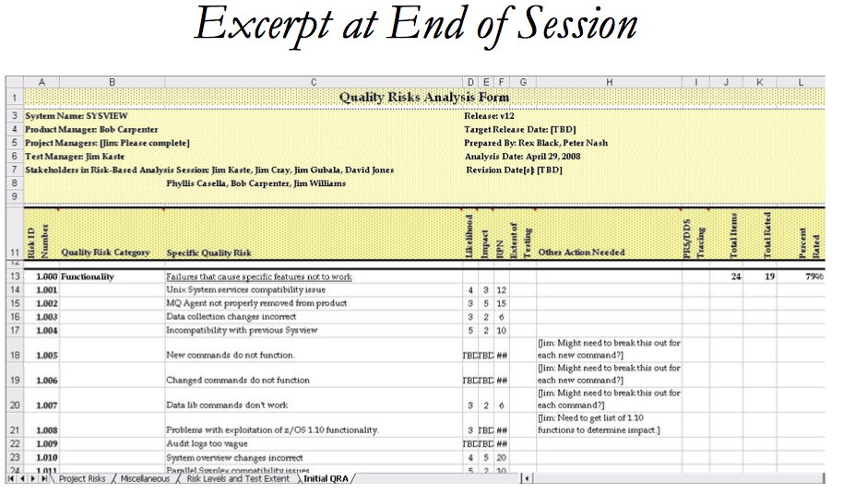
Risk value
Risk category
Risk name
Risk likelihood
Risk impact

Slide 38
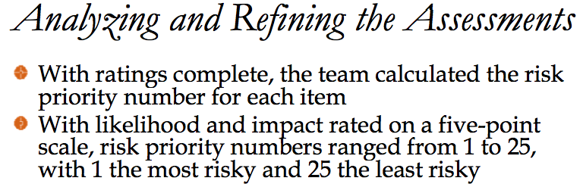

Slide 39
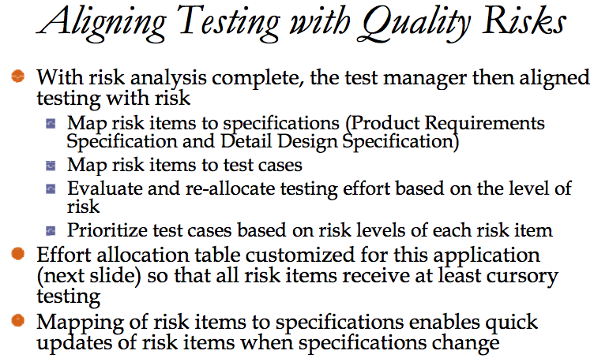

Slide 40
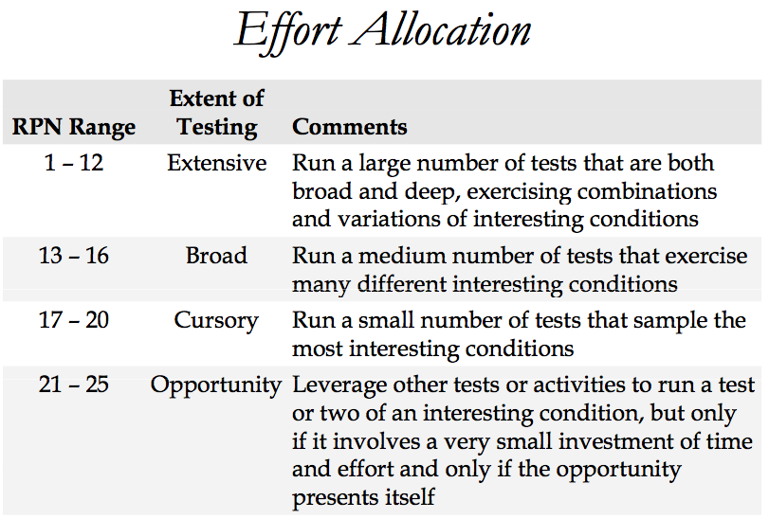

Slide 41
Summary
RBT allows the test team to operate more efficiently and in a targeted fashion, especially in time- constrained and/or resource-constrained situations.
The process of RBT: using risk as a guiding factor all through the testing process
A case study: how to do RBT in practice

Slide 42
Small tasks
Write down your answers
Does RBT increase the test work? (5 mins)
What are the benefits of RBT? (7 mins)
What are the factors that influence the success of RBT in practice? (10 mins)

Slide 43
Reading Material
IEEE Standard 1044-2002: Standard Classification for Software Anomalies
M. Felderer and I. Schieferdecker: A taxonomy of risk-based testing. International Journal Software Tools Technology Transfer. DOI 10.1007/s10009-014-0332-3
Rex Black, Managing the Testing Process, John Wiley, 2002.
Schaefer, Hans: Strategies for Prioritizing Test. STAR WEST 1998.
James Bach, Risk Based Testing, STQEMagazine, Vol1, No. 6.

